Slide 1
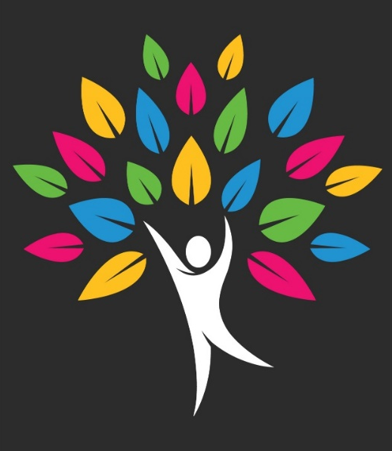
Understanding Feelings & Managing Behaviors
Facilitated By:
Hilary Sahr, AA Human Services
Amber Mckelvey, CSW, MS
Adapted From:
National Child Traumatic Stress Network

Slide 2
Workshop Objectives
Help a child/youth to understand and manage overwhelming emotions.
Know what it takes to become an Emotional Coach for a child/youth.

Slide 3
What is Trauma
An emotional state of profound and prolonged distress in response to an overwhelmingly terrifying or unstable experience.

Slide 4
Why does Trauma Matter?
Many individuals have lived through traumatic experiences.
Individuals carry their trauma experiences with them wherever they go.
Trauma may affect an individual’s behavior, feelings, relationships, and views of the world in profound ways.

Slide 5
Traumatic Events
Threaten or violate one’s safety, health, and integrity
May be directly experienced or witnessed
May cause an overwhelming sense of shame, terror, helplessness, and intense physical effects
May be physical & emotional experiences

Slide 6

CASE STUDY-Peyton

Slide 7
Part 1
What are the child/youth’s behaviors?

Slide 8

Seeing Below the Surface
Behaviors
Feelings, thoughts,
expectations, and beliefs
* Group activity part 1

Slide 9
Part 2
What are the child/youth’s:
  Beliefs and expectations about themselves?
  Beliefs and expectations about others?
  Beliefs and expectations about the world?
  Group activity part 2

Slide 10
Part 3
How can I “re-pack” their suitcase?
How can I add positives experiences and beliefs to their lives?

Slide 11
“Anything that’s human is mentionable,
and anything that is mentionable can be more manageable. When we can talk about our feelings,
they become less overwhelming, less upsetting, and
less scary. The people we trust with that important talk can help us know that we are not alone.”
Fred rogers (Mr. Rogers)

Slide 12

Be an “Emotional Coach”

Slide 13
Feelings Thermometer
Very Hot
Very uncomfortable
Extremely stressed and anxious
Need to get out of here now
Hot
Moderately uncomfortable
Stressed and anxious
Distracted and edgy
Warm
Mildly uncomfortable
Slightly stressed and anxious
Losing my focus
Just right
Comfortable
Not stressed or anxious
Focused and engaged
Cool
A little bored
Losing my focus
Ice Cold
Totally bored
Not focused or engaged
Planning my escape

Slide 14
Emotional Coaching
STEP ONE: Where are you on the thermometer?
STEP TWO: What tools could you use to self-regulate?
STEP THREE: How will you connect with the child/youth?
STEP FOUR: How will you help the child/youth deescalate?
STEP FIVE: How will you help the child/youth identify and label the feelings beneath the outburst?

Slide 15
Limits & Expectations
When setting limits and expectations:
Consider the child/youth’s history – every individual is different
Set one or two limits or expectations before adding to the list
Let the child/youth know the purpose of the limits and expectations is their safety

Slide 16
What about consequences?
Responding to behavior in a trauma-responsive way:
DOES NOT mean excusing behaviors
DOES mean choosing consequences that take the individual’s trauma history into consideration & are the cost effective for the child/youth.
  (Time-in consequences versus Time-out consequences)

Slide 17
Correct & Build
When correcting negatives behavior and choosing consequences:
    Be clear, calm, and consistent
    Target one behavior at a time
    Avoid shaming or threatening
    Keep the child/youth’s age (and “emotional age”) in mind
    Be prepared to “pick your battles”

Slide 18
Correct & Build (cont’d)
AFTER the child/youth is calm, the connections can be made.
Now you can help the child/youth:
    Understand the links between thoughts, feelings, and behavior
    Understand the negative impact of their behavior
    Identify alternatives to problem/negative behaviors

Slide 19
Part 4
What are the negative effects of this behavior on the child/youth’s life?
How can I help them to understand these effects?
What alternatives can I suggest for this behavior?
What consequences can I set if the behavior continues?

Slide 20
Achieving a balance with A Child/Youth
    What talents/skills/interests can you encourage?
    Where can you give them some control?
    What fun activities/interests can you share?
    What kinds of praise would they appreciate?
    What kind of rewards would be most meaningful?

Slide 21
How can we use motivation to help us?
    If they likes to feel powerful; ask for their help “Can you help me set an example for your sisters?”
    If they are very social; likes connection and fun – ask them to organize a game with others
    If they like helping people, avoids conflict –offer reassurance; avoid pressure
    If they are very serious, likes order and internalizes anxiety; offer step by step specific instructions

Slide 22
Review of how you can help
Set an example by using the emotional regulation tools in times of stress.
Help the child/youth define and express their emotions.
Encourage positive emotional expression and behaviors by supporting their strengths and interests.
Correct negative behaviors and inappropriate or destructive emotional expression, and help the child/youth build new behaviors and emotional skills.

Slide 23
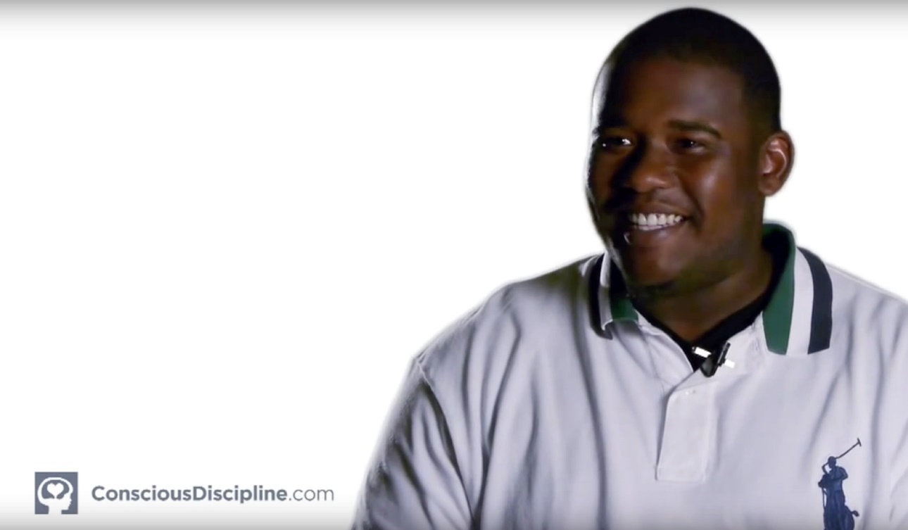
Building on Strengths
Gang Leader to Graduate - A Conscious Discipline Transformation - YouTube

Slide 24
Part 5
What are my child/youth’s strengths to build on?

Slide 25


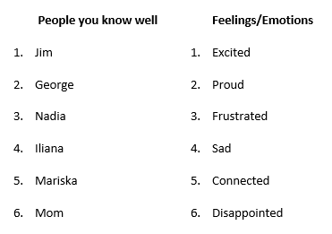


Let’s Play!
What’s My emotion?!

Slide 26

Thank you!
For more information on becoming trauma informed, contact:
  Grant County Trauma Project @
  608-723-2136
Offering Trauma Informed Care:
  Workshops
  Presentations
  Activities

