Slide 1
Youth Safety, Sextortion and AI
Wisconsin Department of Corrections

Slide 2
Specialist Maradith McQuillan
Wisconsin Department of Corrections
Sex Offender Registry

Slide 3
Take Care
Some of this content can be upsetting – take care of yourself
Feel free to step out if you need to.
This is a discussion – please feel free to ask questions – call me out - or add information to the discussion.

Slide 4
A Little Bit About Me
Law Enforcement – SRO and DARE Officer
Public Assistance
Senior Criminal Investigator with State Public Defender’s Office
DOC Sex Offender Registry

Slide 5
Topics
Youth Focused Safety
Sextortion
Artificial Intelligence

Slide 6
Prevalence of Online Abuse
29 million reports of suspected child sexual exploitation are received by the National Center for Missing and Exploited Children per year.
56,4461 per week
1 in 5 youth exploit unwanted exposure to explicit material
1 in 4 experience sexual grooming online

Slide 7
Online Enticement
Online enticement covers a broad spectrum of victimization and occurs on all platforms.
Someone enticing a child online can have a variety of motives and tactics.
Often online enticement involves enticing a child to share sexually explicit images, meeting in person for sexual purposes, engaging the child in a sexual conversation or role-playing or, in some instances, to sell or trade the child’s sexual images to others.

Slide 8
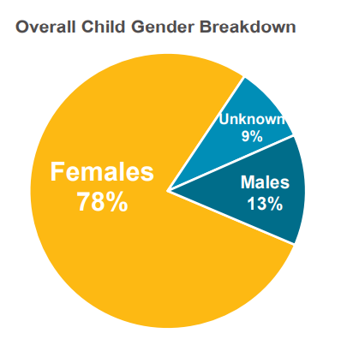
Reported Victims
78% Females
13% males
9% unknown

Slide 9
Offender Demographics
82% male
9% female
9% undetermined

Slide 10
Offender/Child Relationship
98 % unknown to the child
2% known offenders
  Of the known offenders 53% were family members
  56% were male
  Most common reported familial offenders were parents/step children
  37% more distant family members

Slide 11
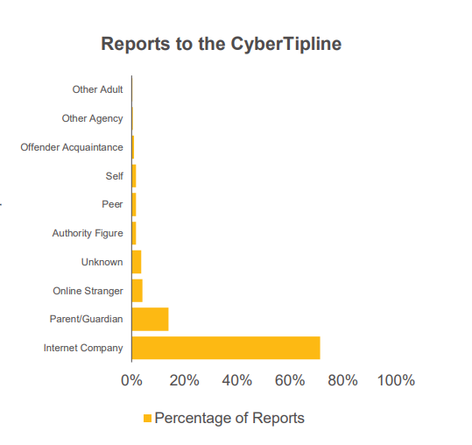
Who most often reports
Internet companies – same for both boys and girls
Parents more likely to report
on behalf of boys

Slide 12
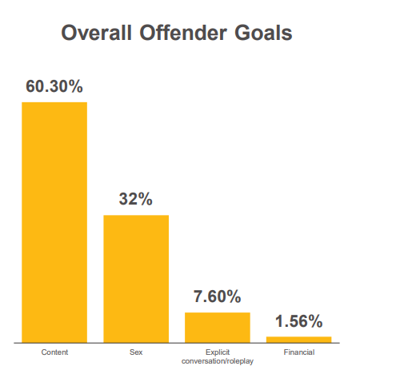
Overall Offender Goals
Many had more than one goal
Boys were more targeted for financial gain
Boys were more likely solicited for images
Girls more likely solicited to meet for sex

Slide 13
How often were goals achieved?
24% of the time images were sent to offender
More commonly images of offender were sent to the child victim
12% mentioned in person meetings
8% reported coordination to meet in person
% of actually meeting offender is unknown due to a variety of factors

Slide 14
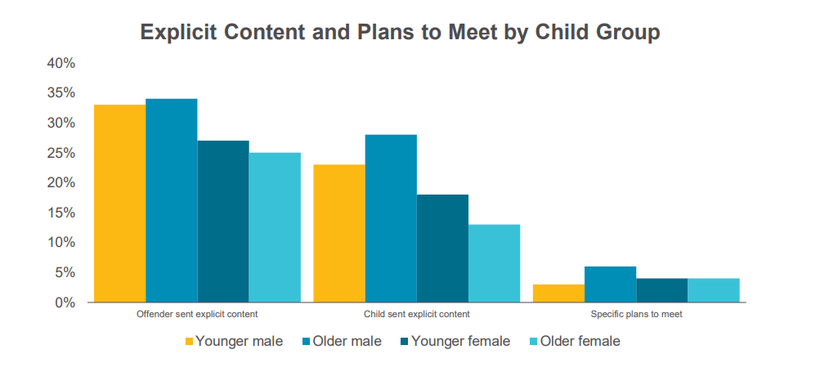
Explicit content/Plans to Meet
Older teen males

Slide 15
Offender Methods
Sexual conversation/role play
Asking for images
Grooming/developing positive rapport
Sending unprompted sexual images of themselves
Pretending to be younger
Offering nude images
Offering financial incentives

Slide 16
Where does this occur online?
Almost every type of online platform has been used
Most offenders report using only one online platform
If using multiple platforms, will switch to platform they use most often
Reports or flagging from internet company was highly effective in offender refraining from using that platform.
For offenders looking to meet children, they primarily used social networking or chat sites
For offenders looking for images the used encrypted apps, livestream sites and texting apps

Slide 17
Age and Gender Differences
Boys, particularly younger boys, more often exchange phone numbers
Boys are more likely to involve gaming platforms
Girls are more likely to use mainstream social media platforms

Slide 18
Concerning APPS
The idea of certain apps being “red flag” apps is a dated concept
  Tik Tok- algorithm can quickly expose users to mature content
  Snapchat – designed for secrecy
  Discord – unmonitored private chats
  KIK- no parental controls
  Omegle – anonymous video chats
  Instagram and Threads – most popular in sextortion cases
  Roblox – in game chat
  Bumble, Grindr, MeetMe. Skout and Badoo – dating and hook up apps
  Telegram- self destructing messages

Slide 19
Parental Control APPS
Bark – Scans messages for potential dangers – geofencing
Qustodio – detailed reports, app usage controls, panic button
Family Time – Geofencing, app blocking, screen time management
Canopy – free trial – content monitoring
Our Family Wizard – Designed for co-parenting and managing communication and schedules

Slide 20
Youth Serving Organizations
National Institute of Justice reports 3 out of 4 adolescents who have been sexually assaulted were victimized by someone they knew well.
90% of children know their abuser
60% of abusers are acquaintances, teachers, neighbors or community members
Not everyone who sexually abuses children is a pedophile
It is a wide range of individuals with diverse motivations

Slide 21
Youth Serving Organizations
The premise – Adults are Responsible for reporting and protecting children from Sexual abuse
Safe to compete – Coaches Training
  safetocompete.org/training
Trainings available through the Department of Corrections:
  Darkness to Light – Stewards of Children
  Awareness to Action

Slide 22
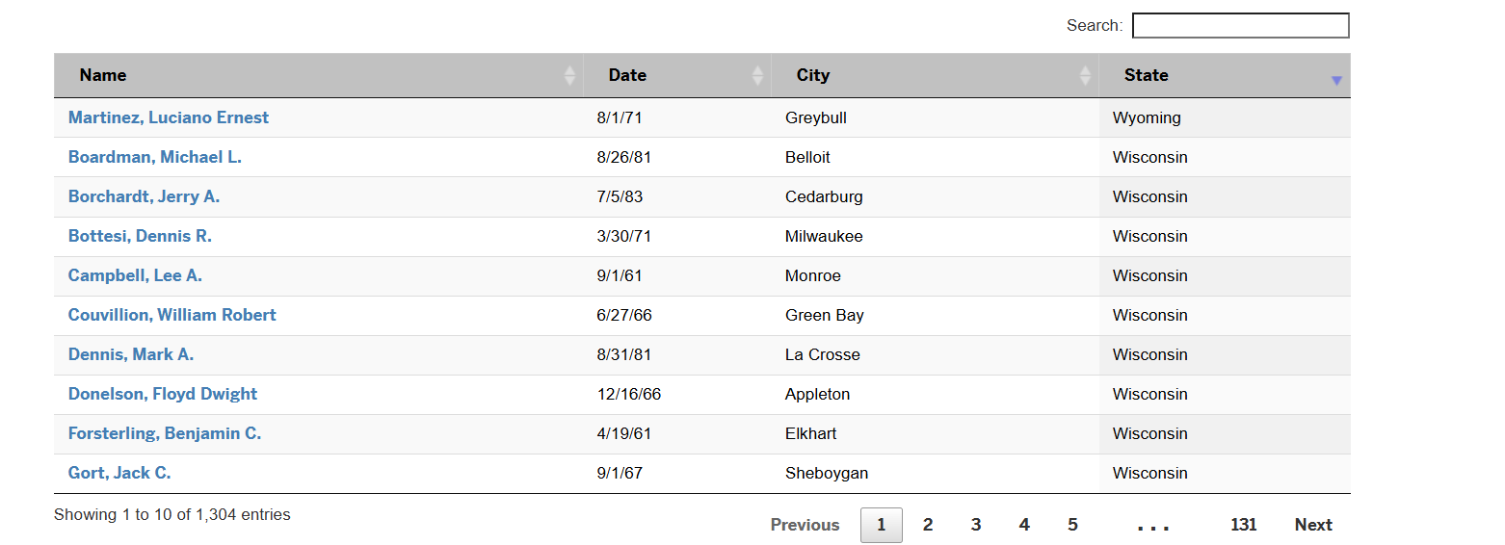
Youth Serving Organizations

Slide 23
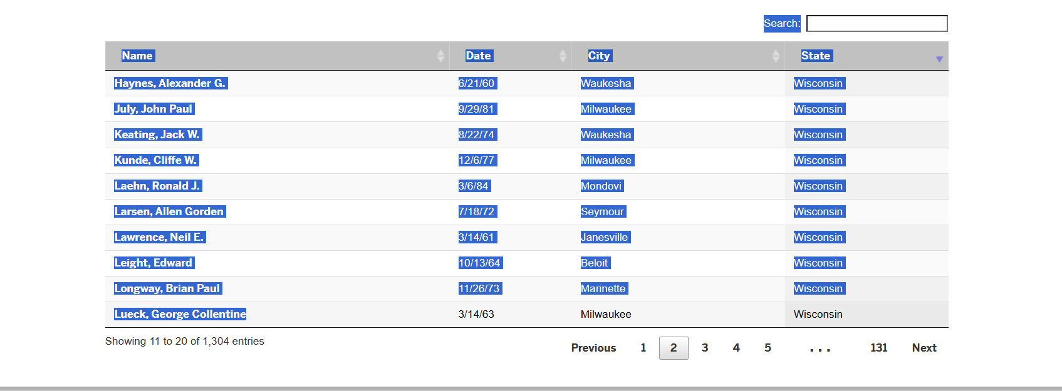
Youth Serving Organizations

Slide 24
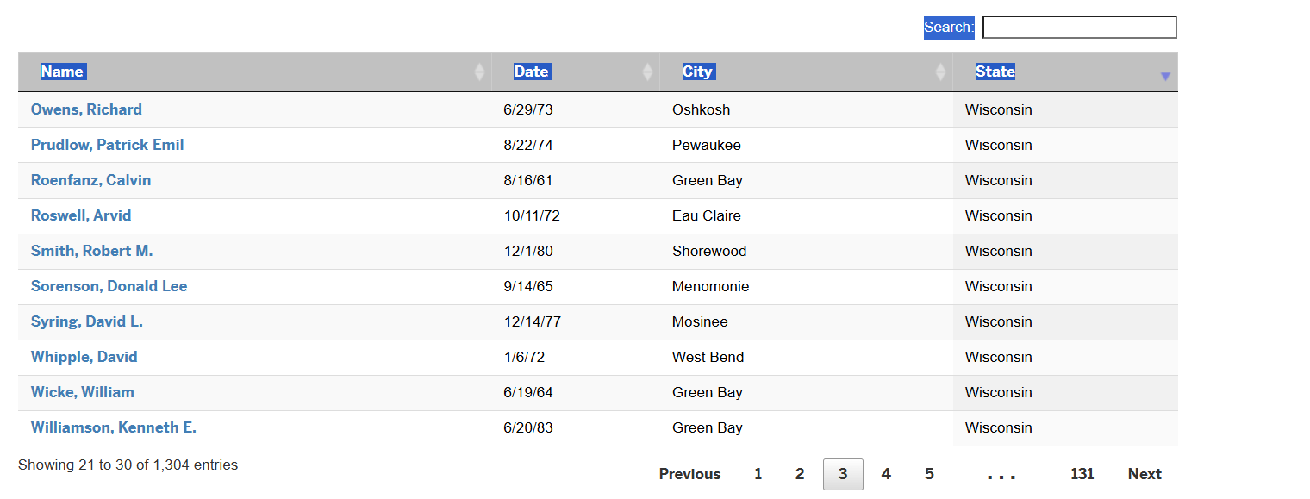
Youth Serving Organizations

Slide 25

Youth Serving Organizations

Slide 26
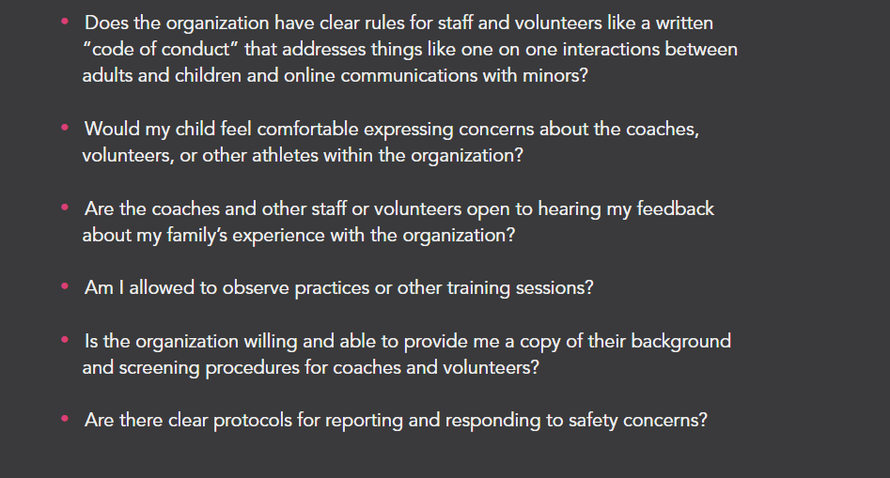
Youth Serving Organizations

Slide 27
Sextortion
What Is Sextortion:
Sextortion is a form of child sexual exploitation where children are threatened or blackmailed, most often with the possibility of sharing with the public a nude or sexual images of them, by a person who demands additional sexual content, sexual activity or money from the child
Reports of Sextortion have increased more than 300% between 2021 and 2023

Slide 28
Sextortion
Many adults hesitate to discuss Sextortion because of the word “Sex”
Is usually initiated by an adult using a social media site – Instagram is most prevalent for initial contact
Will move very quickly and ask for nudes immediately after following or friending a child online
Often have child move to an end to end encrypted site – it is more difficult for authorities to intervene

Slide 29
Sextortion
One of the signature tactics offenders employ is to falsely tell the child they've broken the law by sending nude pics and will be put on a sex offender list if they don't comply with financial demands.
Another is to tell them they will share the photos with everyone the child knows, from parents to teachers to friends and girlfriends to college admissions.

Slide 30
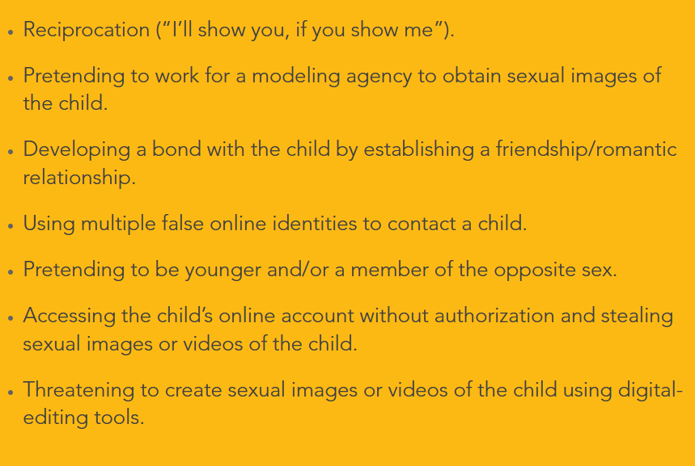
Sextortion

Slide 31
Sextortion
The blackmailer is to blame, not you. Even if you made a choice you regret, what they are doing is a crime.
Get help before deciding whether to pay money or otherwise comply with the blackmailer. Cooperating or paying rarely stops the blackmail.
REPORT the account via the platform’s safety feature.
BLOCK the suspect but DO NOT DELETE your profile or messages because that can be helpful in stopping the blackmailer.

Slide 32
Sextortion
Let NCMEC help get images of you down. Visit MissingKids.org/IsYourExplicitContentOutThere to learn how to notify companies yourself or visit cybertipline.org to report to us for help with the process.
Visit Take It Down so NCMEC can help you get your explicit images removed from the internet. Having nudes online is scary, but there is hope to get them taken down.
Ask for help. The problems can be very complex and require help from adults or professionals. If you don’t feel that you have adults in your corner, you can reach out to NCMEC for support at gethelp@ncmec.org or you can call us at 1-800-THE-LOST.

Slide 33
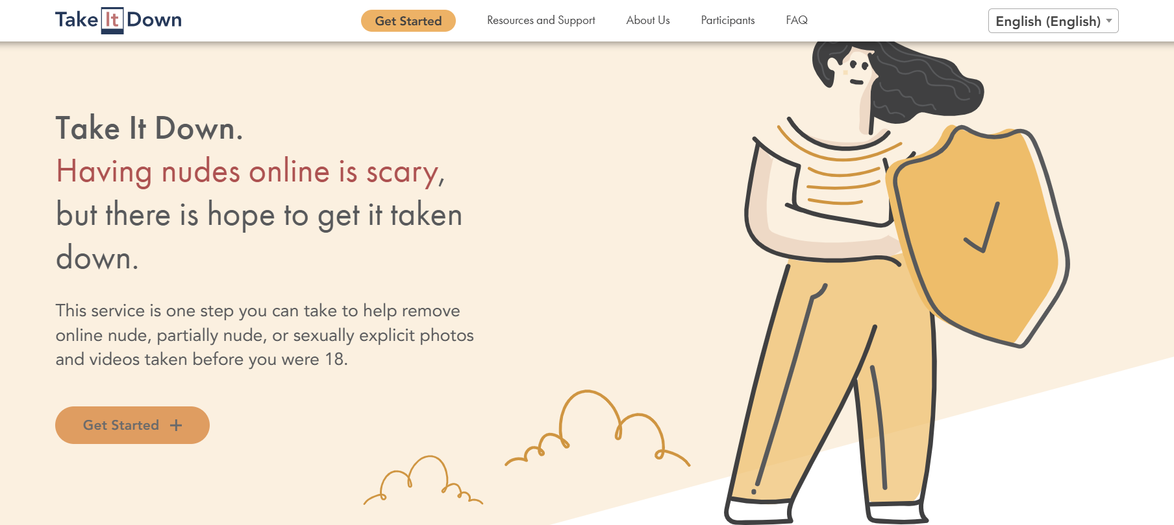
Sextortion

Slide 34

Sextortion

Slide 35
Sextortion
2025 ASSEMBLY BILL 201 Bradyn's Law is a proposed bill in Wisconsin that aims to combat the growing issue of sextortion and protect children from its devastating consequences.
Key aspects of Bradyn's Law include:
The bill is named after Bradyn Bohn, a 15-year-old who died by suicide after being a victim of sextortion.
It would establish sexual extortion as a stand-alone crime in Wisconsin. This differs from the current system, where perpetrators are charged with related offenses that carry less severe penalties.

Slide 36
Sextortion
The bill suggests increased penalties, beginning with a Class I felony. Penalties could escalate based on factors such as the victim's age or harm.
A significant provision allows for a felony murder charge if the sextortion leads to the victim's suicide.
Victims or their families could receive compensation from the Wisconsin Department of Justice's crime victim compensation fund.
The bill has bipartisan support and was drafted with Bradyn's parents and Wisconsin Attorney General Josh Kaul.

Slide 37
Sextortion
It has passed the Wisconsin Assembly and is moving to the state Senate for approval before potentially going to the Governor.

Slide 38
Sextortion
In Bradyn’s case – after he was contacted on Facebook, the perpetrator persuaded him to move the conversation to Telegram.
Once photos were exchanged, the conversation turned dire.
If you don't send me this money in 30 seconds, I'm sending these photos to everyone you know.
Part of what makes teenagers feel they can't step away is that offenders will message relentlessly, deploying countdowns

Slide 39
Sextortion
Bradyn relented to the demand for money. He sent $300 through a payment platform, but that only intensified the messages.
Within hours of endless torment and threats, Bohn was dead.
His note said, ‘Make sure he gets caught,’”. “‘I’m so sorry. Everything’s on my phone.’”

Slide 40
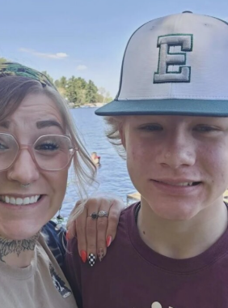
Nobody talks about it, because people think it’s shameful,” Bird said during recent legislative testimony, which drew tears from lawmakers. “I’ve never been ashamed of my kid. He’s 15. He’s doing what 15-year-olds do.”
Brittney Bird – Bradyn’s mom

Slide 41
Generative AI (GAI)
Generative Artificial Intelligence (GAI) technology allows a user to create new images, videos, audio and text based on user requests or promp
Over the past two years, NCMEC’s CyberTipline has received more than 7,000 child sexual exploitation reports involving GAI, and the numbers are expected to grow as we continue to track these trends

Slide 42

Generative AI (GAI)

Slide 43
Generative AI (GAI)
GAI Exploitative Imagery: GAI is being used to create child sexual abuse material (CSAM) that depicts children engaged in sexually explicit conduct and nude images of children like content created by “nudify” apps.
The creation and distribution of this fake imagery – including synthetic media, digital forgery and nude images of children – can have serious legal consequences and cause severe harm to victims, including harassment, bullying and psychological and emotional harm.

Slide 44
Generative AI (GAI)
Online Enticement: Individuals can use GAI tools to create fake accounts on social media to communicate with a child with the intent to commit a sexual offense
Sextortion: Offenders can use GAI to create explicit images of a child that are used to blackmail the child for additional sexual content, coerce a child to engage in sexual activity or to obtain money. NCMEC has seen cases in which the child refuses to send a nude image to the offender, and the offender then creates an explicit GAI image of that child to blackmail them for more explicit images.

Slide 45
Generative AI (GAI)
AI Bullying and Peer Victimization: GAI technology may be used to create or spread harmful content, such as fake images or videos. This content is often created by a child’s classmates and can end up circulating in schools.

Slide 46
Generative AI (GAI)
Text prompts
Little girl 6 years old prostitute
Little 4 years gold girl BDSM
Naked 6 year old child public orgy

Slide 47
Generative AI (GAI)
In Wisconsin law it is referred to “Synthetic Media.”
Act 123 requires Synthetic Media to be labeled and include a disclaimer
Act 224 criminalized AI Generated CSAM – “depiction of a purported child” whether it actually does or not
Also banned child sex dolls

Slide 48
Generative IA (GAI)
There have been some recent legal challenges based on a Wisconsin case.
Holmen WI
Allegedly used an AI image generator – Stable Diffusion- and created over 13,000 images depicting child sexual abuse.
The system he used generated FAKE images, some AI platforms use images of known people

Slide 49
Generative AI (GAI)
caught when he was boasting to a 15 year old male child about creating the images.
sent sexually explicit images of the prepubescent boys he created to the child on Instagram
This behavior generated a cyber tip to NCMEC
LE obtained a warrant and found AI generated images of children wearing BDSM themed leather clothing
encouraged others to go to Telegram to “check out what they were missing.”

Slide 50
Generative AI (GAI)
Discussed desire to have sex with boys via Instagram – said he lives with his wife and child in Wisconsin.
Discussed how he evades detection of GAI models that produces sexually inappropriate content.
4 years prior LE had a tip this person was requesting to download CSAM on a peer to peer network.
Is also facing charges for 1st Degree Sexual Assault of a Child – under 13
Two counts of exposing children to harmful materials

Slide 51
Generative AI (GAI)
A judge ruled the First Amendment protects the possession of “virtual child pornography” in their home
Federal prosecutors are appealing

Slide 52
Generated AI (GAI)
Real or AI images can be removed using Take It down Services
Often devastating for children and their families
GAI platforms are required to detect, remove and report attempts to create child exploitation content

Slide 53
Available Training
For Adults – Darkness to Light – Stewards of Children
Awareness to Action
Safe to Compete
NCMEC Connect
For kids of all ages
  Netsmartz – online safety – ages 5-17
  Kidsmartz – personal safety for K-5

Slide 54
Thank You
Your Name
Phone Number
Email Address
Website URL

