Slide 1
Hospital At Home
The crash course

Slide 2
Educational Background
Bachelors, Business Administration (East Carolina University 2012’)
Concentration : Marketing

Slide 3
Educational Background
Bachelors, Business Administration (East Carolina University 2012’)
Masters , Business Administration (East Carolina University 2014’)

Slide 4
Educational Background
Bachelors, Business Administration (East Carolina University 2012’)
Masters , Business Administration (East Carolina University 2014’)
You are correct…. I have no formal clinical experience!

Slide 5
Educational Background
Bachelors, Business Administration (East Carolina University 2012’)
Masters , Business Administration (East Carolina University 2014’)
You are correct…. I have no formal clinical experience!

Slide 6
Professional Background
Director of Business Development, December 2013 - June 2020
Chief Operations Officer, May 2020 – Present

Slide 7
Professional Background
Director of Business Development, December 2013 - June 2020
Chief Operations Officer, May 2020 – Present

Slide 8
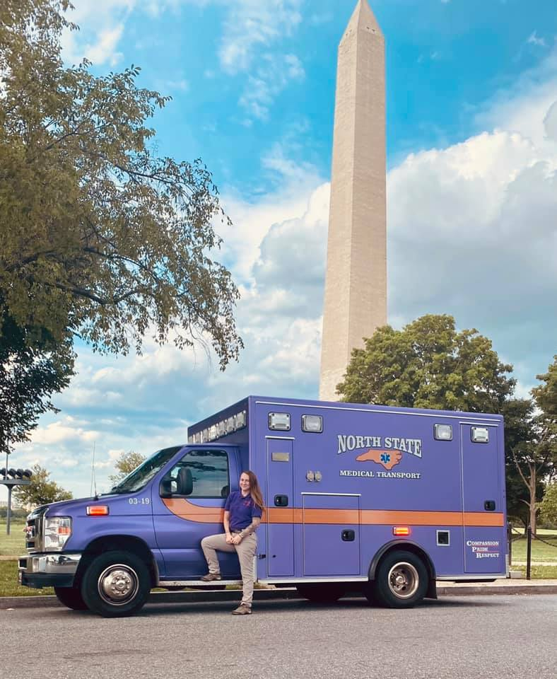
Agency Background
Founded in 2004 by three Wake County Paramedics
Private “For Profit” Company
Non-Hospital Based
Franchised in 13 North Carolina counties (serving approximately 2.2 million citizens)
Primary Focus (prior to MIH initiative) = BLS and ALS non-emergent transportation
Backup 911 (mutual aid) in 11 of 13 franchised counties

Slide 9
Hospital at Home – Operating Model
Telehealth Model and Equipment Provider
In-Home Providers (MIH)
Healthcare System

Slide 10
Hospital at Home – Operating Model
Acute Care at Home – Post ED Referral
Patient referred by ED physician into respective “Hospital at Home” program
Patient must meet certain criteria for Hospital at Home (examples):
Is patient able to walk without assistance?
Is wi-fi access readily available at residence?
Will patient’s insurance cover the respective program?
Patient arrives at Emergency Department
ED Physician sends referral to respective “control center”
“Control center” conducts social screening, chart overview, and makes final decision on eligibility
If eligible, Mobile Integrated Healthcare providers are contacted to begin scheduling and logistics

Slide 11
Hospital at Home - Existing Model
Acute Care at Home – Post ED Referral
Patient referred by ED physician into respective “Hospital at Home” program
Patient must meet certain criteria for Hospital at Home (examples):
Is patient able to walk without assistance?
Is wi-fi access readily available at residence?
Will patient’s insurance cover the respective program?
Patient arrives at Emergency Department
ED Physician sends referral to respective “control center”
“Control center” conducts social screening, chart overview, and makes final decision on eligibility
If eligible, Mobile Integrated Healthcare providers are contacted to begin scheduling and logistics

Slide 12
Hospital at Home - Existing Model
Patient arrives at Emergency Department
ED Physician sends referral to respective “control center”
“Control center” conducts social screening, chart overview, and makes final decision on eligibility
If eligible, Mobile Integrated Healthcare providers are contacted to begin scheduling and logistics
Who Makes Up The ”Control Center”?
Case Managers
Service Coordinators
Telehealth RNs
Telehealth MDs
Health System Day-to-Day Managers

Slide 13
Hospital at Home - Existing Model
Patient arrives at Emergency Department
ED Physician sends referral to respective “control center”
“Control center” conducts social screening, chart overview, and makes final decision on eligibility
If eligible, Mobile Integrated Healthcare providers are contacted to begin scheduling and logistics
Who Makes Up The ”Control Center”?
Case Managers
Service Coordinators
Telehealth RNs
Telehealth MDs
Health System Day-to-Day Managers

Slide 14
Hospital at Home - Existing Model
Patient arrives at Emergency Department
ED Physician sends referral to respective “control center”
“Control center” conducts social screening, chart overview, and makes final decision on eligibility
If eligible, Mobile Integrated Healthcare providers are contacted to begin scheduling and logistics
Who Makes Up The ”Control Center”?
Case Managers
Service Coordinators
Telehealth RNs
Telehealth MDs
Health System Day-to-Day Managers

Slide 15
Hospital at Home - Existing Model
Patient arrives at Emergency Department
ED Physician sends referral to respective “control center”
“Control center” conducts social screening, chart overview, and makes final decision on eligibility
If eligible, Mobile Integrated Healthcare providers are contacted to begin scheduling and logistics
Who Makes Up The ”Control Center”?
Case Managers
Service Coordinators
Telehealth RNs
Telehealth MDs
Health System Day-to-Day Managers

Slide 16
Hospital at Home - Existing Model
Patient arrives at Emergency Department
ED Physician sends referral to respective “control center”
“Control center” conducts social screening, chart overview, and makes final decision on eligibility
If eligible, Mobile Integrated Healthcare providers are contacted to begin scheduling and logistics
Who Makes Up The ”Control Center”?
Case Managers
Service Coordinators
Telehealth RNs
Telehealth MDs
Health System Day-to-Day Managers

Slide 17
Implementation
Ready. Set. Let’s Go.

Slide 18
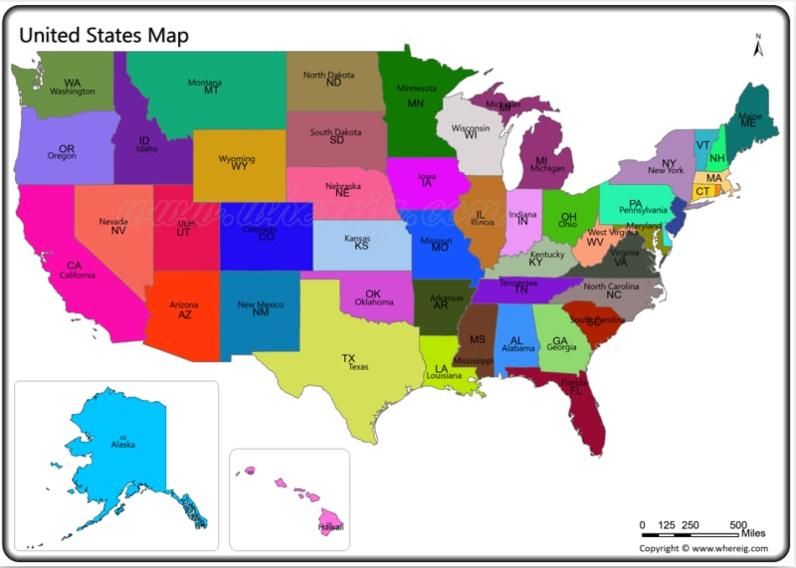
Implementation – State Compliance
Know your state’s respective ruling on “alternative setting” practices for Paramedics and other advanced practice resources

Slide 19
Implementation – State Compliance
Know your state’s respective ruling on “alternative setting” practices for Paramedics and other advanced practice resources
Are Paramedics currently legally able to utilize their clinical skills in private residences in your state?

Slide 20
Implementation – State Compliance
Know your state’s respective ruling on “alternative setting” practices for Paramedics and other advanced practice resources
Would clinical decision- making fall under your Medical Director?
Are Paramedics currently legally able to utilize their skills in private residences?

Slide 21
Implementation – State Compliance
Know your state’s respective ruling on “alternative setting” practices for Paramedics and other advanced practice resources
Would clinical decision- making fall under your Medical Director?
Are Paramedics currently legally able to utilize their skills in private residences?
… or under your health system’s Medical Director?

Slide 22
Implementation – State Compliance
Are they able to practice to their full scope?
Know your state’s respective ruling on “alternative setting” practices for Paramedics and other advanced practice resources
Would clinical decision- making fall your Medical Director?
Are Paramedics currently legally able to utilize their skills in private residences?
… or under the health system’s Medical Director?

Slide 23
Implementation – State Compliance
North Carolina – Emergency Medical Services and Trauma Rules
10A NCAC 13P .0506 PRACTICE SETTINGS FOR EMS PERSONNEL
“ Individuals functioning in an *alternative practice setting* …… that are not affiliated with an EMS system shall..”

Slide 24
Implementation – State Compliance
North Carolina – Emergency Medical Services and Trauma Rules
10A NCAC 13P .0506 PRACTICE SETTINGS FOR EMS PERSONNEL
“ Individuals functioning in an alternative practice setting …… that are not affiliated with an EMS system shall..”
1) Be under the medical oversight of a physician licensed by the North Carolina Medical Board that is associated with the practice setting where the individual will function; and

Slide 25
Implementation – State Compliance
North Carolina – Emergency Medical Services and Trauma Rules
10A NCAC 13P .0506 PRACTICE SETTINGS FOR EMS PERSONNEL
“ Individuals functioning in an alternative practice setting …… that are not affiliated with an EMS system shall..”
1) Be under the medical oversight of a physician licensed by the North Carolina Medical Board that is associated with the practice setting where the individual will function; and 2) Be restricted to performing within the scope of practice as defined by the North Carolina Medical Board pursuant to G.S. 143-514 for the individual's level of EMS credential.

Slide 26
Implementation The Health System (from the MIH provider’s view)

Slide 27
Health System can be any of the following:
Hospital System
Single Hospital
Physicians Group
Private Decentralized Health Groups
Secondary Care Management Companies
Primary Care conglomerate

Slide 28
Health System can be any of the following:
Hospital System
Single Hospital
Physicians Group
Private Decentralized Health Groups
Secondary Care Management Companies
Primary Care conglomerate
….many more to come!!!

Slide 29
Health System can be any of the following:
Hospital System
Single Hospital
Physicians Group
Private Decentralized Health Groups
Secondary Care Management Companies
Primary Care conglomerate
….many more to come!!!

Slide 30
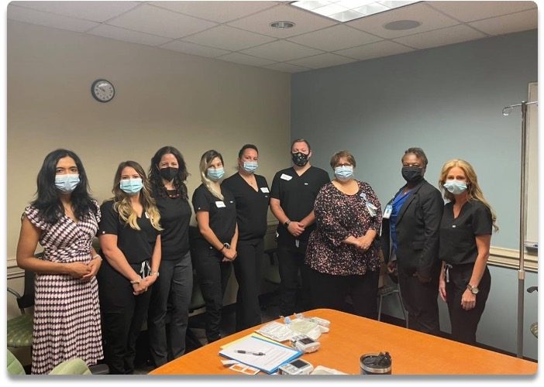
Implementation – Your Health System
Beginning Day 1: Arrange weekly virtual or in-person “touch points”
June 2021: Our team and the Hospital Team (60 days before launch)

Slide 31
Implementation – Your Health System
Beginning Day 1: Arrange weekly virtual or in-person “touch points”
Do not assume everyone is on the same page!
June 2021: Our team and the Hospital Team (60 days before launch)

Slide 32
Implementation – Your Health System
Arrange weekly virtual or in-person “touch points”
Discuss and set your agency’s expected formulary and supplies for your hospital-at-home endeavor
June 2021: Our team and the Hospital Team (60 days before launch)

Slide 33
Implementation – Your Health System
Arrange weekly virtual or in-person “touch points”
Discuss and set your agency’s expected formulary and supplies
But…. Expect this to change… again…. And again
June 2021: Our team and the Hospital Team (60 days before launch)

Slide 34
Implementation – Your Health System
Arrange weekly virtual or in-person “touch points”
Discuss and set your agency’s expected formulary and supplies
But…. Expect this to change… again…. And again
..and again
…. and again
…….and again
June 2021: Our team and the Hospital Team (60 days before launch)

Slide 35
Implementation – Your Health System
Arrange weekly virtual or in-person “touch points”
Discuss and set your agency’s expected formulary and supplies
Rates (Fee Schedule) negotiations should start immediately!
But…. Expect this to change… again…. And again
June 2021: Our team and the Hospital Team (60 days before launch)

Slide 36
Implementation – Your Health System
Arrange weekly virtual or in-person “touch points”
Discuss and set your agency’s expected formulary and supplies
Rates (Fee Schedule) negotiations should start immediately!
Coordinate hands-on training within the respective health system, prior to launch date!
June 2021: Our team and the Hospital Team (60 days before launch)

Slide 37
Implementation – Your Health System
Arrange weekly virtual or in-person “touch points”
Discuss and set your agency’s expected formulary and supplies
Rates (Fee Schedule) negotiations should start immediately!
Coordinate hands-on training within the respective health system, prior to launch date!
Builds trust between the entities
One Team. One Goal. Better Patient Care.
June 2021: Our team and the Hospital Team (60 days before launch)

Slide 38
Implementation – Your Health System
Arrange weekly virtual or in-person “touch points”
Discuss and set your agency’s expected formulary and supplies
Rates (Fee Schedule) negotiations should start immediately!
Coordinate hands-on training within the respective health system, prior to launch date!
Obtain forecasted census and anticipated volume
June 2021: Our team and the Hospital Team (60 days before launch)

Slide 39
Implementation – Your Health System
But above all else…..

Slide 40
Implementation – Learn and Do Better
Be ready to adapt and make changes at any given time.
Everyone is learning!

Slide 41
Implementation – Vehicles

Slide 42
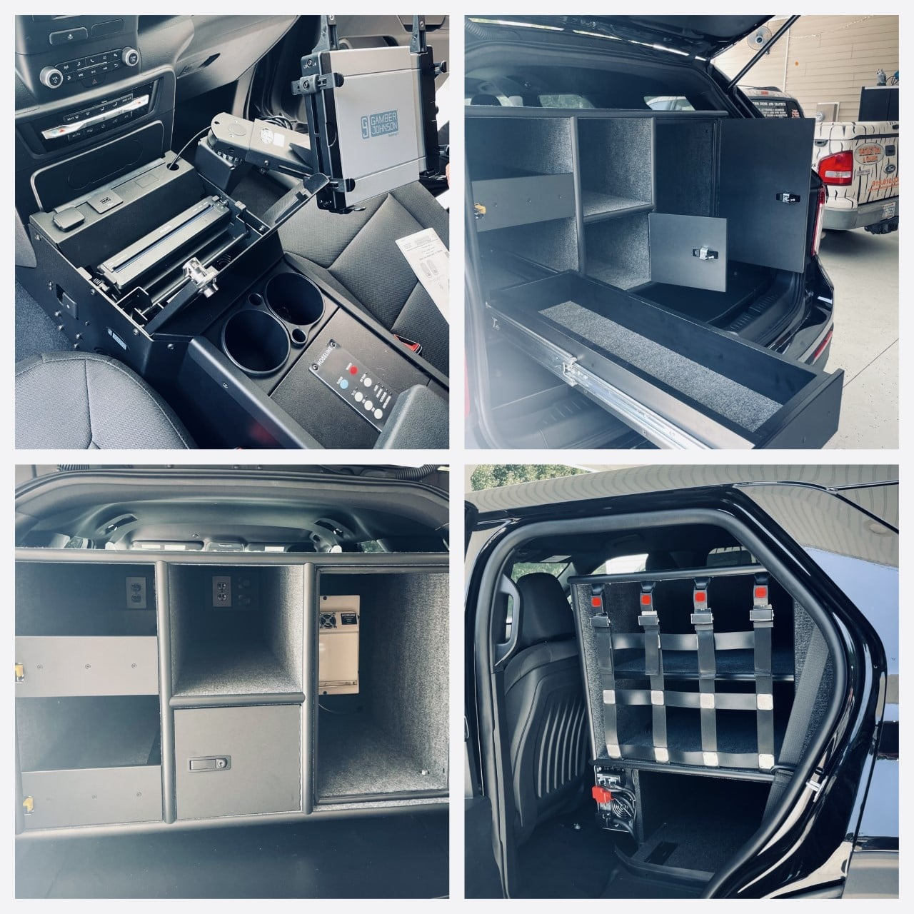
Implementation - Vehicles
MRV 1 (Purchased April 2021)
Ford Explorer - Utility Package - $35,000
Custom Rockland Cabinetry - $7,000
Custom Refrigeration System - $3,000
In-Console Bluetooth Printer - $1,000
Toughbook Holder - $300
Decals - $1,500
Total Cost - $48,000 (approximate)

Slide 43
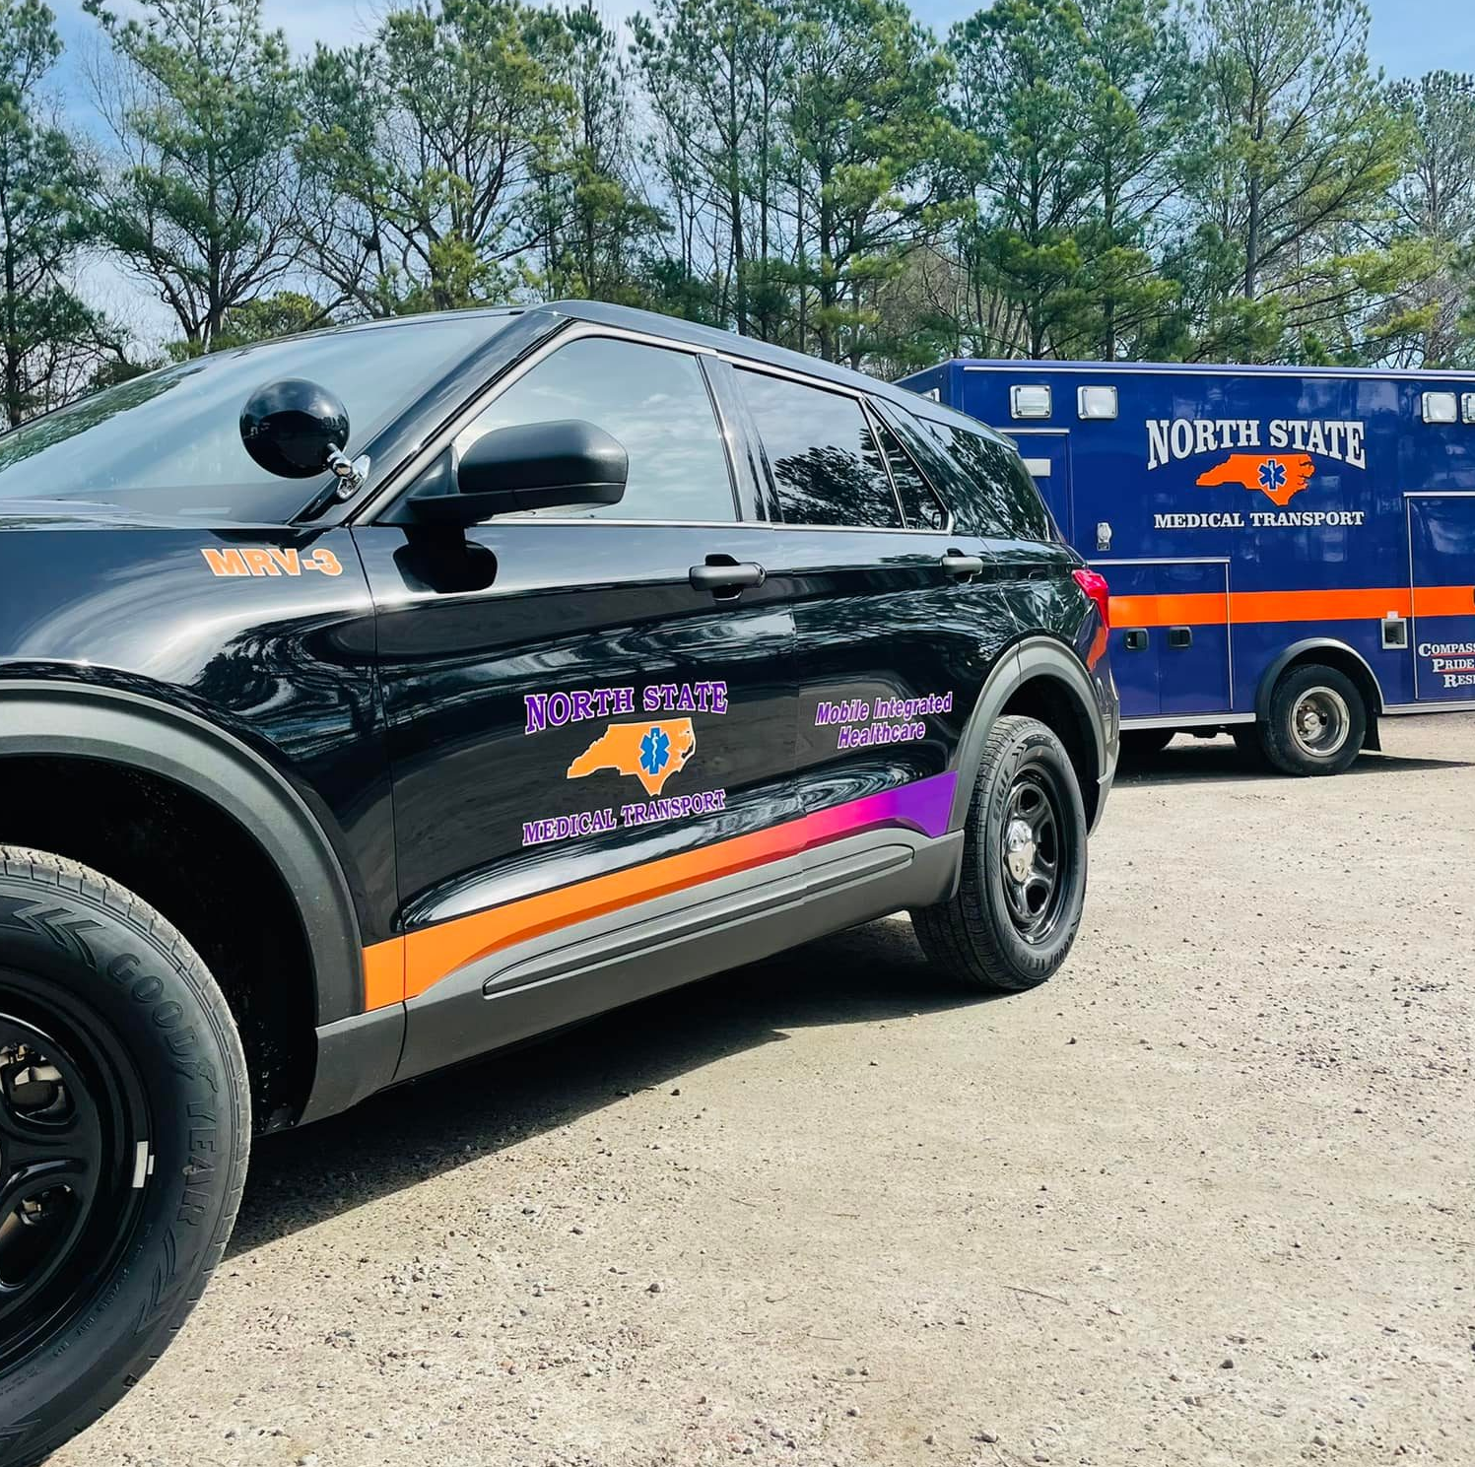
Implementation - Vehicles
MRV 3 (Purchased December 2021)

Slide 44
Implementation - Vehicles
MRV 3 (Purchased December 2021)
Ford Explorer - Utility Package - $35,000
Custom Rockland Cabinetry - $7,000
Custom Refrigeration System - $3,000
In-Console Bluetooth Printer - $1,000
Toughbook Holder - $300
Decals - $1,500

Slide 45
Implementation - Vehicles
MRV 3 (Purchased December 2021)
Ford Explorer - Utility Package - $35,000
Custom Rockland Cabinetry - $2,500 (Was $7,000)
Custom Refrigeration System - $3,000
In-Console Bluetooth Printer - $1,000
Toughbook Holder - $300
Decals - $1,500

Slide 46
Implementation - Vehicles
MRV 3 (Purchased December 2021)
Ford Explorer - Utility Package - $35,000
Custom Rockland Cabinetry - $2,500
Custom Refrigeration System - $3,000
In-Console Bluetooth Printer - $1,000
Toughbook Holder - $300
Decals - $1,500

Slide 47
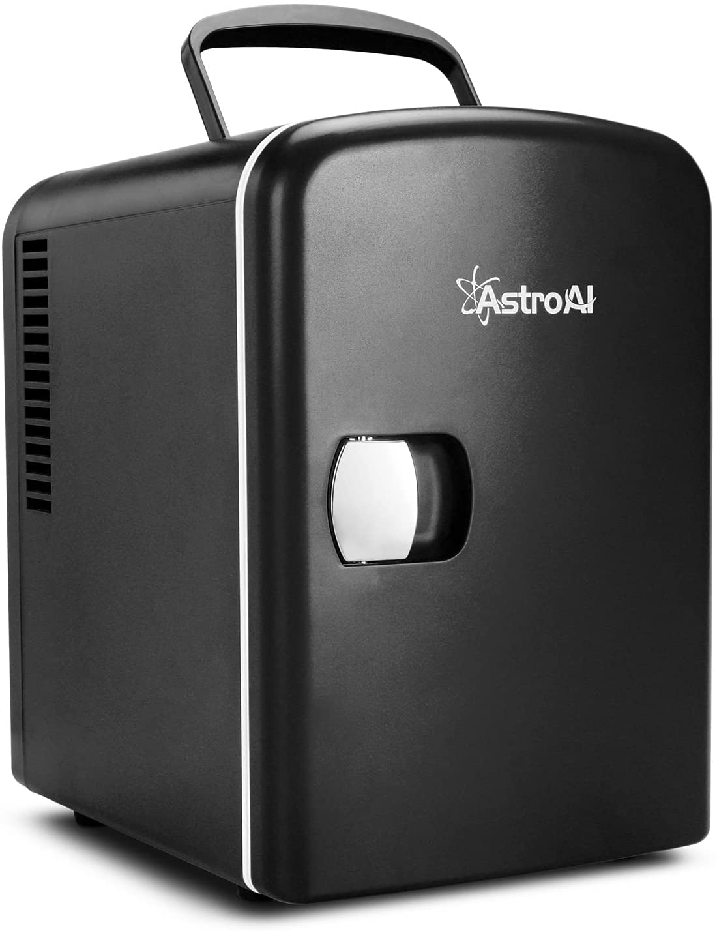
Implementation - Vehicles
MRV 3 – Purchased December 2021
Ford Explorer - Utility Package - $35,000
Custom Rockland Cabinetry - $2,500
Portable Refrigerator - $79 (was $3,000)
In-Console Bluetooth Printer - $1,000
Toughbook Holder - $300
Decals - $1,500

Slide 48
Implementation - Vehicles
MRV 3 – Purchased December 2021
Ford Explorer - Utility Package - $35,000
Custom Rockland Cabinetry - $2,500
Portable Refrigerator - $79
In-Console Bluetooth Printer - $1,000
Toughbook Holder - $300
Decals - $1,500

Slide 49
Implementation - Vehicles
MRV 1 Cost – $48,000
MRV 3 Cost - $39,000
(savings of $9,000)

Slide 50
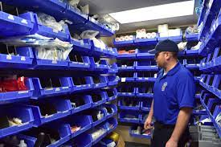
Implementation – Supplies and Formulary
Supplies and Formulary – Comprehensive list generally supplied by respective health system or healthcare platform to Mobile Integrated Healthcare Provider. (Should be done at least 90 days before launch)

Slide 51
Implementation – Supplies and Formulary
Supplies and Formulary – Comprehensive list generally supplied by respective health system or healthcare platform to Mobile Integrated Healthcare Provider. (Should be done at least 90 days before launch)
Demand transparency – Go line by line with healthcare administration; Do not purchase all items on list without conversation and clarity.

Slide 52
Implementation – Supplies and Formulary
Supplies and Formulary – Comprehensive list generally supplied by respective health system or healthcare platform to Mobile Integrated Healthcare Provider. (Should be done at least 90 days before launch)
Demand transparency – Go line by line with healthcare administration; Do not purchase all items on list without conversation and clarity.
Show off your expertise! They know the hospital… but you know the “field”

Slide 53
Implementation – Supplies and Formulary
Supplies and Formulary – Comprehensive list generally supplied by respective health system or healthcare platform to Mobile Integrated Healthcare Provider. (Should be done at least 90 days before ”Live”
Demand transparency – Go line by line with healthcare administration; Do not purchase all items on list without conversation and clarity.
Internally price out all supplies and medications with your respective supplier (examples: Boundtree and McKesson)

Slide 54
Implementation – Supplies and Formulary
Supplies and Formulary – Comprehensive list generally supplied by respective health system or healthcare platform to Mobile Integrated Healthcare Provider. (Should be done at least 90 days before ”Live”
Demand transparency – Go line by line with healthcare administration; Do not purchase all items on list without conversation and clarity.
Internally price out all supplies and medications with your respective supplier
Be honest and direct – Advise healthcare system of any concerns you have regarding specific supplies or medications

Slide 55
Implementation – Supplies and Formulary
Supplies and Formulary – Comprehensive list generally supplied by respective health system or healthcare platform to Mobile Integrated Healthcare Provider. (Should be done at least 90 days before ”Live”
Demand transparency – Go line by line with healthcare administration; Do not purchase all items on list without conversation and clarity.
Internally price out all supplies and medications with your respective supplier
Be honest and direct – Advise healthcare system of any concerns you have regarding specific supplies or medications
CLIA ”Moderately Complex” Licensure Needed? – Begin process as soon as you can! (Needed for select ”point of care” testing)

Slide 56
Implementation – Recruitment & Retention

Slide 57
Implementation – Recruitment and Retention
You get what you pay for!

Slide 58
Implementation – Recruitment and Retention
You Get What You Pay For!
April 2021 - $22.00/hour starting pay
October 2021 - $27.00/hour starting pay

Slide 59
Implementation – Recruitment and Retention
You Get What You Pay For!
27.00/hour starting pay
Create Scheduling That Makes Sense For Your Agency!
What are the hours of operations for your new program?
What is the ideal scheduling for the Paramedics in your system?
What is your initial payroll budget?
Is there a need for 24-hour shifts?
Demand for overnight response calls?
Don’t make it too complicated! Go with what you know!

Slide 60
Implementation – Recruitment and Retention
You Get What You Pay For!
27.00/hour starting pay
Create Scheduling That Makes Sense
Coordinate “meet and greet” with each MIH provider and the “control center” team.
Builds trust
Sets foundation for a mutual relationship
MIH provider should observe “control center” for a shift

Slide 61
Implementation – Recruitment and Retention
You Get What You Pay For!
27.00/hour starting pay
Create Scheduling That Makes Sense
Foster ”control center” relationship
Encourage continuous and open feedback from your MIH providers!

Slide 62
Implementation – Recruitment and Retention
You Get What You Pay For!
27.00/hour starting pay
Create Scheduling That Makes Sense
Foster ”Control Center” relationship
Encourage open feedback from your MIH providers
Be their advocate!
New environment for most Paramedics
Keep clinical and assessment confidence high!
Document any discrepancies or concerns between your team and the health system’s team, for case review

Slide 63
Implementation – Fee Schedule ($$$)

Slide 64
Implementation – Fee Schedule
Confirm the types of services your team will be providing in the Hospital at Home program

Slide 65
Implementation – Fee Schedule
Confirm the types of services your team will be providing in the Hospital at Home program
The 33% Rule

Slide 66
Implementation – Fee Schedule
Confirm the types of services your team will be providing in the Hospital at Home program
The 33% Rule (I’ll get back to this)

Slide 67
Implementation – Fee Schedule
Confirm the types of services your team will be providing in the Hospital at Home program
The 33% Rule
Be transparent with decision makers regarding your internal payroll, supplies, overhead, vehicle, and billing costs!

Slide 68
Implementation – 33 % Rule
When computing your price point for services rendered, compute the direct payroll costs for the MIH provider’s shift.
Ex: 24-hour shift at $27/hour = $648
Sorry… it’s math time!

Slide 69
Implementation – 33 % Rule
When computing your price point for services rendered, compute the direct payroll costs for the MIH provider’s shift.
Ex: 24-hour shift at $27/hour = $648
Sorry… it’s math time!

Slide 70
Implementation – 33 % Rule
When computing your price point for services rendered, compute the direct payroll costs for the MIH provider’s shift.
Ex: 24-hour shift at $27/hour = $648 in direct payroll costs
Revenue goal for services rendered during 24-hour shift should be 3x the direct payroll costs

Slide 71
Implementation – 33 % Rule
When computing your price point for services rendered, compute the direct payroll costs for the MIH provider’s shift.
Ex: 24-hour shift at $27/hour = $648 in direct payroll costs
Revenue goal for services rendered during 24-hour shift should be 3x the direct payroll costs
This is where that 33% comes from

Slide 72
Implementation – 33 % Rule
When computing your price point for services rendered, compute the direct payroll costs for the MIH provider’s shift.
Ex: 24-hour shift at $27/hour = $648 in direct payroll costs
Revenue goal for 24-hour shift should be 3x the direct payroll costs
$648 x 3 = $1,944 in services rendered goal for one 24-hour shift ($648 is 33% of $1,944)

Slide 73
Implementation – 33 % Rule
When computing your price point for services rendered, compute the direct payroll costs for the MIH provider’s shift.
Ex: 24-hour shift at $27/hour = $648 in direct payroll costs
Revenue goal for 24-hour shift should be 3x the direct payroll costs
$648 x 3 = $1,944 in services rendered goal for one 24-hour shift ($648 is 33% of $1,944)
Note: Every company is different! This is what our team used to successfully implement and profit

Slide 74
Implementation – Fee Schedule
Other Factors to Consider:
Direct Billing? (Negotiate terms easier)
Is your existing ambulance sector involved in program?
What is your forecasted share of full program’s visits?
Inflation (watch pricing on supplies and meds - weekly)

Slide 75
Implementation – Fee Schedule
Recommended Fee Schedule Items:
Routine Service Fee
Primary / Initial Introduction Service Fee
Discharge Fee
”Escalated” Service Fee
Rx Surcharge Fee
Supply Surcharge Fee

Slide 76
Implementation – Contract Terms
Factors to keep in mind:
Protect your entity
Extended contract length
No room for gray areas in contract
Detailed fee schedule and terms
Billing terms (30-day, 100% reimbursement)
Billed monthly to health system
Get Creative
Daily service minimums?
Leave room for change!
Rx price increases? Payroll increases?
Ensure language exists that protects your bottom line

Slide 77
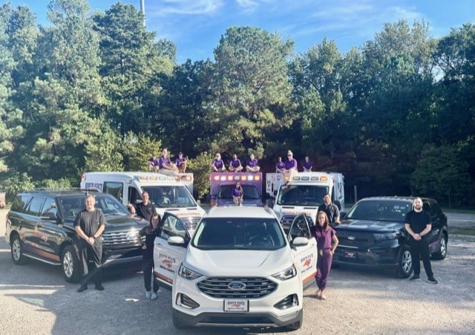
Hospital at Home Ready for Launch
✅ MIH Providers
✅ Supplies and Meds
✅ Rate Schedule Secured
✅ Workflow Finalized
✅ Vehicles Stocked
✅ Contract Signed
✅ CLIA / Regulatory
✅ Dispatchers educated
✅ All modules ready

Slide 78
Hospital at Home – Our Workflow
Ambulance Transport Home
BLS ambulance brings patient home to be admitted into Hospital at Home program.
MIH Paramedic meets patient and crew at residence
Paramedic’s initial responsibilities include setting up telehealth equipment and patient education
After all clinical orders are complete, MIH Paramedic travels to next appointment
Formal/Verbal communication between our Paramedic and “control center” is constant!

Slide 79
Hospital at Home – Our Growth
September 2021 - 20 patients admitted

Slide 80
Hospital at Home – Our Growth
September 2021 - 20 patients admitted
October 2021- 27 patients admitted

Slide 81
Hospital at Home – Our Growth
September 2021 - 20 patients admitted
October 2021- 27 patients admitted
November 2021 – 27 patients admitted

Slide 82
Hospital at Home – Our Growth
September 2021 - 20 patients admitted
October 2021- 27 patients admitted
November 2021 – 27 patients admitted
December 2021 – 30 patients admitted

Slide 83
Hospital at Home – Our Growth
September 2021 - 20 patients admitted
October 2021- 27 patients admitted
November 2021 – 27 patients admitted
December 2021 – 30 patients admitted
January 2022 – 50 patients admitted

Slide 84
Hospital at Home – Our Growth
September 2021 - 20 patients admitted
October 2021- 27 patients admitted
November 2021 – 27 patients admitted
December 2021 – 30 patients admitted
January 2022 – 50 patients admitted
Total Patients Admitted: 154

Slide 85
Hospital at Home - Our Statistics
Average revenue per patient = $1,583

Slide 86
Hospital at Home - Our Statistics
Average revenue per patient = $1,583
Average length of stay in Hospital at Home = 4 days

Slide 87
Hospital at Home - Our Statistics
Average revenue per patient = $1,583
Average length of stay in Hospital at Home = 4 days
Average number of visits per patient = 7 visits throughout stay

Slide 88
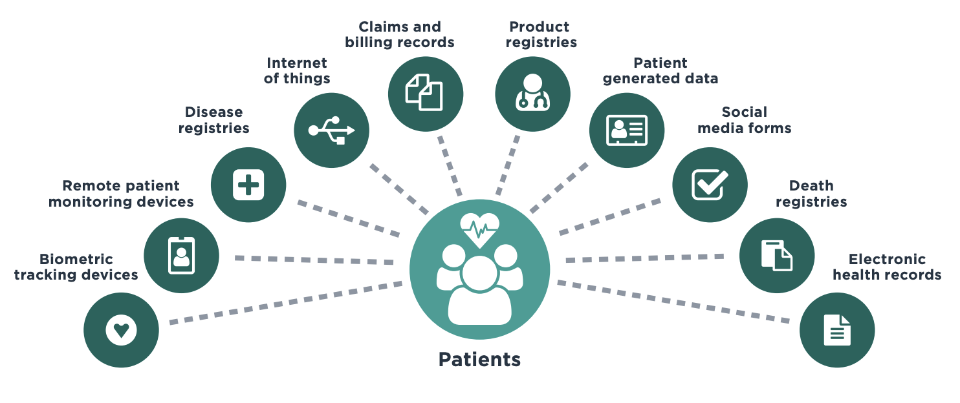
Mobile Integrated Healthcare– The Future

Slide 89
You Got This!
Have More Questions?
Email: Ccoward@nsmt.biz
Find me on LinkedIn! : Carlie Coward-Dodson

