Slide 1
Toward a New Understanding of Frequency- and Impedance-Related Failures in Grounding Systems
NAB Las Vegas 2020
Thomas LaBarge, Nancy Swartz, Gordon Wysong, John Broccoli, and John H. Belk
GROUNDLINX™
Blue Ridge, Georgia, USA
info@groundlinx.com

Slide 2
Introduction
Lightning-related costs are worse than we’d like to admit
Many of these expenses are related to grounding issues exacerbated by antiquated technology
New technology solutions proven in other industries can be applied to create effective mitigation for some of these issues

Slide 3
Issues Worsened by High Resistance Soil
Much of the soil across the USA exhibits high electrical resistance.
The simple Sphere of Influence theory becomes overly optimistic with high resistance soil.
Homogenous soil rarely exists in real-world installations.
The sides and the end of a ground rod do not emit equally.
Measurements of Resistance-to-Ground (RTG) are often misleading due to variations in resistance.
Meter readings are of a single moment, missing impact of weather and corrosion over time.
Ground loops result in misunderstood/bad readings. (Any reading below 1 ohm is always suspect)
Should we expect a low power measurement device to put out enough energy to mimic lightning?

Slide 4
Issues Worsened by High Resistance Soil, cont.
Standard ground rod or ground plate dissipation capability is sub-par.
Skin Depth Effect (SDE) limits frequency response, especially for high resistance soil.
Ground rod surface area and smooth surfaces limit dissipation.
Ground rod surface interface-to-soil is poorly addressed
Standard ground rods, ground plates, and ground straps are no longer sufficient.
Broadband faults are more likely with increasing distribution, transmission of content and high frequency (HF) allocation expansion (5G, WiFi6, ATSC 3.0).
Lightning is a broadband event.

Slide 5
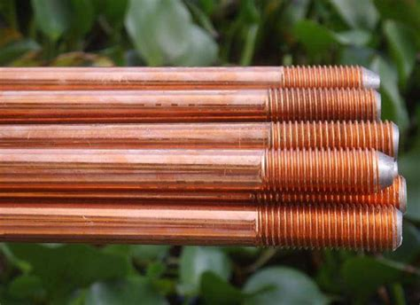
Mitigating these Issues
Improve dissipation of high frequency fault currents in all soil types
Reduce impedance mismatches, especially in poor soil
There’s more to good grounding than lots of rods driven into dirt.

Slide 6
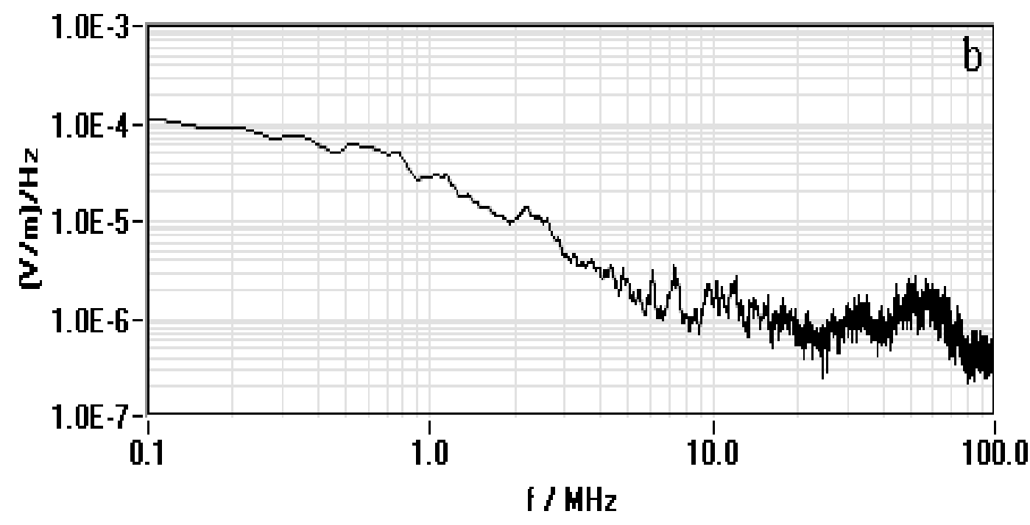
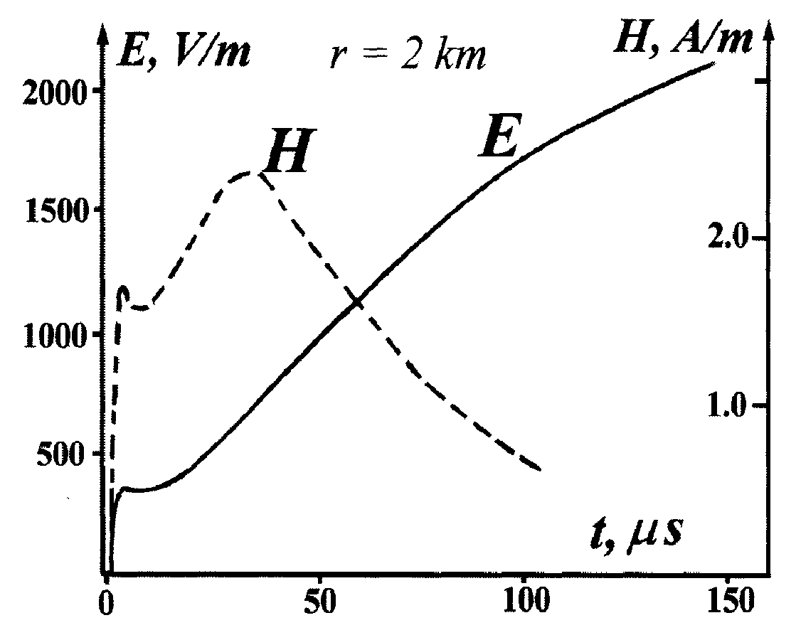
Lightning’s High Frequency Content
Pulse shape showing steep front edge. Electric field (E) and magnetic field (H) both have steep rises which create lots of high frequencies.
Cloud-to-cloud electric field (E) average (applicable to aircraft, mountain installations, and very tall towers.)
The 60 MHz “hill” is less pronounced for cloud-to-ground events.
Chen et. al., CAS.
Bazelyan and Raizer, 2000, Figure 3.23, 2 km.

Slide 7
Grounding Systems Experience High Frequencies
The roll-out of digital data distribution and transmission systems brings with it more high frequencies and a greater potential of resultant faults.
Steep waveforms in lightning discharges indicate high frequency content.
Lightning contains a lot of high frequency energy beyond 200 MHz.
Simple copper-based ground rods in good soil can dissipate daily use amounts of the lower frequencies fairly well but the higher frequencies remain relatively undiminished.

Slide 8
High Frequency Impact on Grounding Systems
Due to a skin depth effect (SDE), high frequencies migrate to nearer the surface of cables and other conductive devices. This makes the surface area of the conductor a likely driver of dissipation paths during grounding.
High frequency fault mitigation has historically been addressed by a network of wide copper strapping, however…
When a wide copper strap is connected to a standard grounding ring or rod array, the surface area is significantly reduced by the copper strap blocking transfer of high frequencies and then...
A reflection of current or a sublimation event is likely.

Slide 9
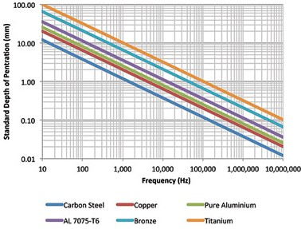
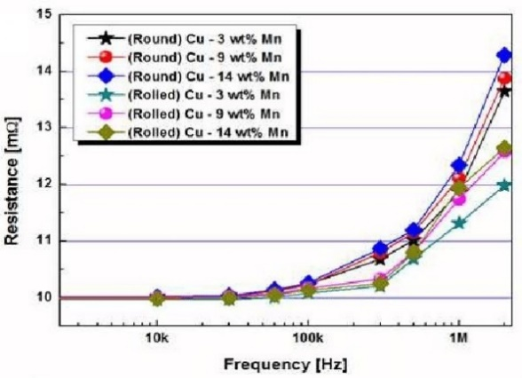
High Frequency Impact on Grounding Systems
To respond appropriately to the frequencies that occur at first impact in discharges and surges, specialized materials and structures must be considered.
Surface area, skin depth and dissipation properties affect end-to-end performance. Every connection and system element must be considered for level of contribution or resistance.
Although copper is accepted as the primary grounding material, typical grounding structures are limited at frequencies exceeding 100 KHz.
Skin Depth Effect

Slide 10
The Impedance Mismatch is HUGE!
Soil is almost 1 trillion times more resistive than metal.
The design of the Grounding System must account for the condition of the earth into which the charge will be expelled.
Soil has about a trillionth the conductivity of copper and air is about a trillionth the conductivity of soil; electrical charge would much rather jump into soil than the air but your tower or building looks quite tempting.
1 TRILLION TIMES!

Slide 11
Impedance Mismatch
In a fault event, impedance mismatches between the grounding system and the native soil cause voltage and frequencies to be contained primarily along the ground rod’s copper skin until at the tip it is either reflected or discharged.
Current rejected by the soil (due to rod-to-soil impedance mismatch), even for a matter of milliseconds, increases charge density upstream.
The volume of initial and subsequent electron flow contained in the strike cannot be decreased if electrons are unable to escape the ground rod
When a critical volume of charge is exceeded at ground rod entry an alternate exit will be achieved, sometimes spectacularly
Failure of the grounding system to immediately and effectively dissipate the trailing/returning charge means the current must seek an alternate path of lower resistance to the surrounding soil.

Slide 12
Accepted Grounding Techniques Challenged NAB 2020 Dynamics of Impedance Mismatch
The impedance mismatch between the ground rod and the soil must be mitigated. One way is to change the interface’s electrical properties from a “wall” to a series of descending steps.
Common additives surrounding bare electrodes to reduce impedance have various drawbacks:
Inorganic salts (sodium chloride, etc.) are highly corrosive to metallic electrodes
Additives to improve electrolytic characteristics of soil are often soluble in rain water and must be replenished
Bentonite clays become insulating to fault currents at high frequencies
“Conductive cement” containing copper or carbon can suffer significant corrosion over time worsened by possible impurities in the poured material

Slide 13
What can be done?
Consider including durable, non-corrosive materials in standard installations
Incorporate continuous high frequency dissipation components into existing and new grounding systems
Establish an impedance gradient within the native soil throughout the grounding network design
Be aware that low RTG readings at a single moment in time are not nearly the whole story

Slide 14
Summary
The U.S. insurance industry reports claims of $1 Billion annually for lightning strike damage and lightning-related surges
Resistance-to-Ground readings alone are an inaccurate representation of capability to dissipate current in strike or surge events
Commonly accepted grounding system designs do not account for millisecond dispersion of frequencies which can exceed 100 MHz
The impedance mismatch between grounding rods and native soil can create a rejection of electrons resulting in reflection of current back upstream

Slide 15
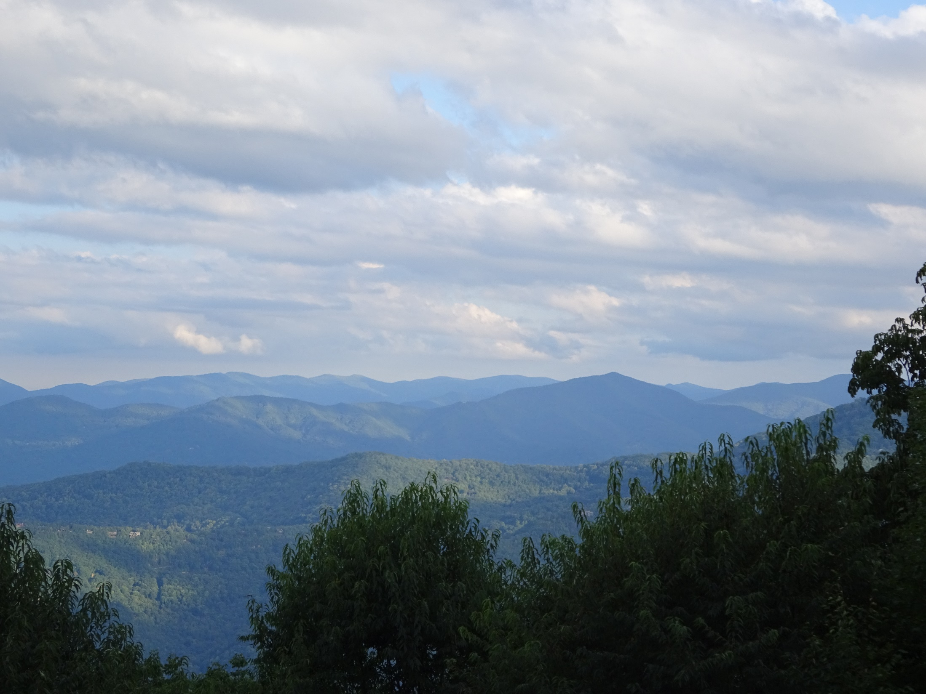
Thank You !!
Your questions are welcomed.
Additional background on GroundLinx Technologies and our approach to grounding is available at www.groundlinx.com
The Appalachian Mountain range is one of the oldest on earth. In its youth, its mountains reached heights similar to those found in the Alps today. Over the last 200 million years, it has eroded to its current state leaving a thick layer of soil displaying high electrical resistance. The knowledge gleaned from learning how to address system grounding in such soil led to the formation of GroundLinx Technologies and the hard fought learnings discussed herein.

